Slide 1
Introduction to Optoelectronic Devices

Slide 2
Outline
What is optoelectronics?
Major optoelectronic devices
Current trend on optoelectronic devices

Slide 3
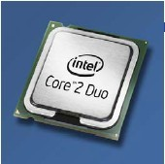
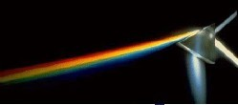
What Did the Word “Opto- Electronics” Mean?
Optoelectronics is the study and application of electronic devices that interact with light
Electronics (electrons)
Optics (light or photons)
Optoelectronics

Slide 4
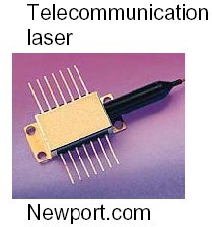
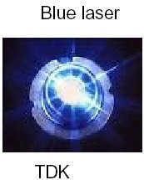
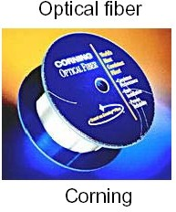
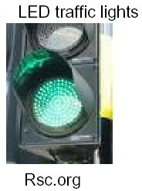
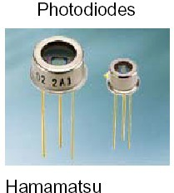
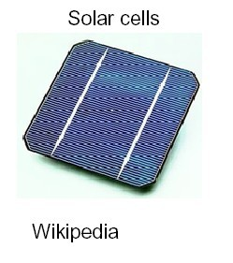
Examples of Optoelectronic Devices

Slide 5
Major Optoelectronic Devices
— Direct Conversion Between Electrons and Photons
Light-emitting diodes (LEDs) (display, lighting,···)
Laser diodes (LDs)
(data storage, telecommunication, ···)
Photodiodes (PDs) (telecommunication, ··· )
Solar Cells (energy conversion)

Slide 6
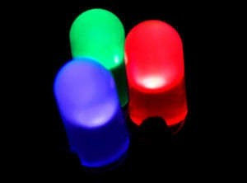
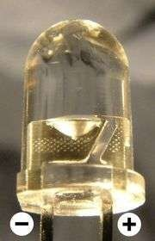
Light-Emitting Diodes (LEDs)
Light-emitting diode (LED) is a semiconductor diode that emits incoherent narrow-spectrum light when electrically biased in the forward direction of the p-n junction.
6

Slide 7
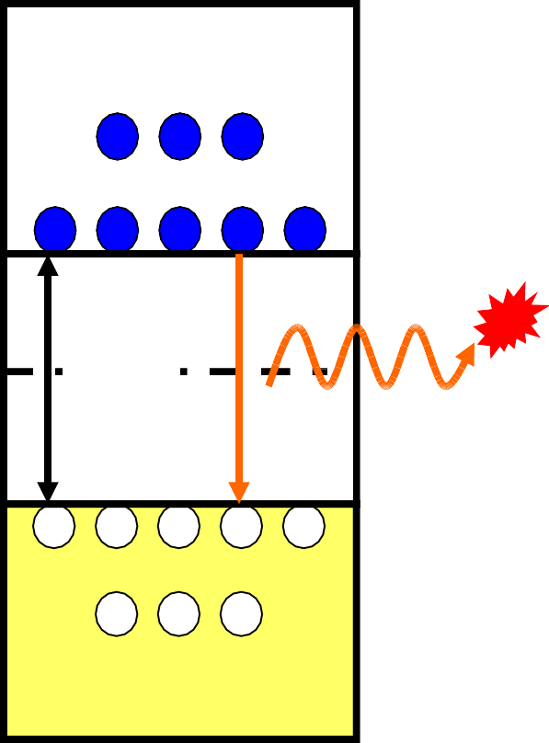
Photon Emission in Semiconductor
Conduction band
Photon
When an electron meets a hole, it falls into a lower energy level, and releases energy in the form of a photon.
The wavelength of the light depends on the band gap of the semiconductor material
E
C
E
E_{g}
F
E_{V}
Valence band
Semiconductor materials: Si, Ge, GaAs, InGaAs, AlGaAs, InP, SiGe, etc

Slide 8
Semiconductor Materials vs. LED Color
General Brightness
GaP | GaN | GaAs | GaAIAs | --
Green, Red | Blue | Red, Infrared | Red, Infrared | --
Super Brightness
GaAIAs | GaAsP | GaN | InGaN | GaP
Red | Red, Yellow | Blue | Green | Green
Ultra Brightness
GaAIAs | InGaAIP | GaN | InGaN | --
Red | Red, Yellow, Orange | Blue | Green | --

Slide 9

Application of LEDs
Display
Solid-state lighting
Communication
Remote control, etc
LED lights on an Audi S6

Slide 10
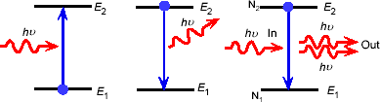
Laser Diodes (LDs)
Lasers (Light Amplification by Stimulated Emission)
Photon emission processes:
Absorption Photodetectors
Spontaneous emission LEDs
Stimulated emission Lasers

Slide 11
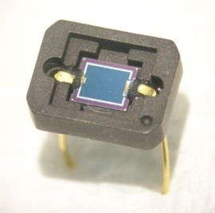
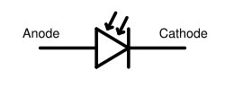
Photo Diodes (PDs)
A photodiode is a semiconductor diode that functions as a photodetector. It is a p-n junction or p-i-n structure. When a photon of sufficient energy strikes the diode, it excites an electron thereby creating a mobile electron and a positively charged electron hole

Slide 12
PDs’ Detection Range and Materials
Material
Silicon (Si) Germanium (Ge)
Indium gallium arsenide
(InGaAs)
Lead sulfide (PbS)
Wavelength range (nm)
190–1100
400–1700
800–2600
<1000-3500

Slide 13
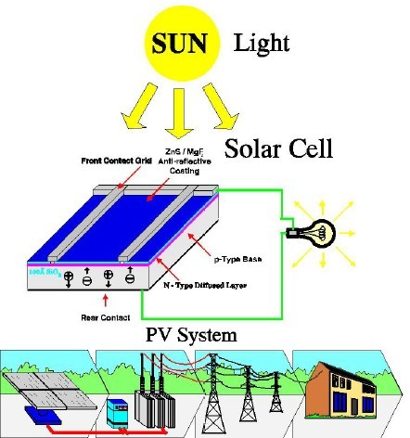
Vision of Solar Cells (Photovoltaics)
Why solar cells?
Solar Energy
•
•
•
Free
Essentially Unlimited Not Localized
Solar Cells
•
•
•
•
•
Direct Conversion of Sunlight → Electricity No Pollution
No Release of Greenhouse-effect Gases No Waste or Heat Disposal Problems
No Noise Pollution — very few or no moving parts
No transmission losses — on-Site Installation
•

Slide 14






Residential and Commercial Applications
Challenges:
cost reduction via: a) economy of scales b) building integration and
c) high efficiency cells
14

Slide 15
Trends in optoelectronic devices
Long wavelength, high power light sources or photodetectors
Nanoscale devices
Low cost, easy fabricated materials
High opto-electronic conversion efficiency
Multi-wavelength sources
15

Slide 16
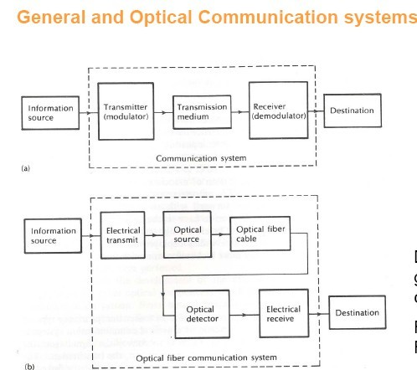

Slide 17
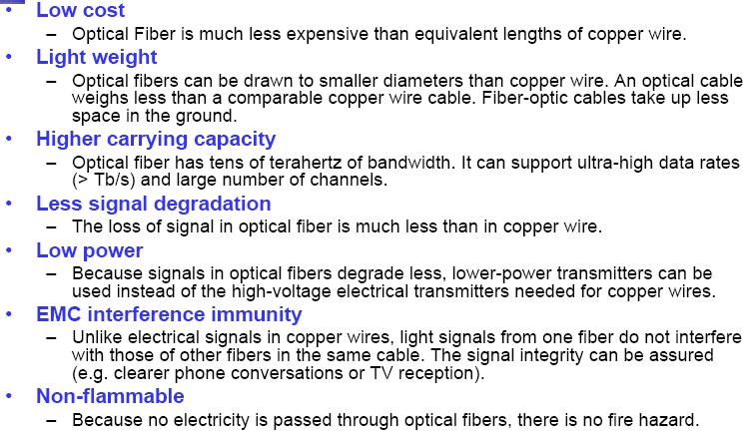
Advantages of Optical Comm.

